Slide 1
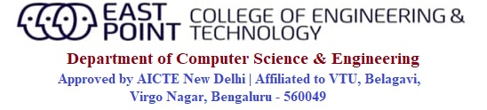
Internship(21INT49) on
Hotel Billing System
Presented by, | Under the guidance of, Prof. Manimegalai Assistant Professor Department of CSE, EPCET
Pritish Ali USN: 1EP21CS076

Slide 2
CONTENTS:
Introduction
About Industry
Aim and Objectives of the Internship
Hardware and Software Requirements
Internship Implementation
Result and Result Analysis
Conclusion
References

Slide 3
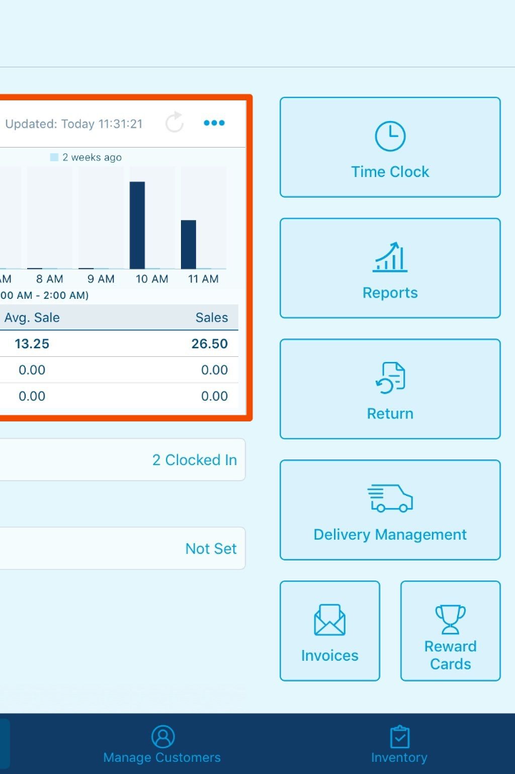

Billing System of Hotel using Java
Welcome to this presentation on the hotel billing system implementation using Java. Discover how we can create a flexible and efficient system to manage billing processes with ease.
by Pritish Ali

Slide 4

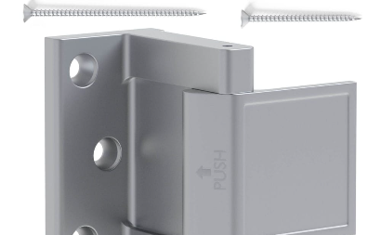

Introduction to the Hotel Billing System
The hotel billing system is a software application that streamlines billing processes and enhances efficiency. In this section, we will brief about what the hotel billing system is and how can we benefit from it.
Financial Management
Security and Privacy
Time Saving
The software provides a central repository for managing all financial transactions related to the hotel business.
The hotel billing system ensures the privacy of customer data by implementing advanced security protocols.
The system automates many of the billing processes, which helps to save time and enables faster service delivery.

Slide 5
Designing the System with Java
Java is a widely used programming language in the development of enterprise-level applications. In this section, let's see how we can design a hotel billing system with Java.
1
System Architecture
We start by designing the fundamental architecture of the application, which includes the front-end and back-end components.
Class Designing
2
We then create class diagrams and establish the relationship among various classes.
3
Coding and Debugging
After designing, we can move into the implementation stage, which includes coding and debugging the application code.

Slide 6
Key Features of the System
The hotel billing system is a feature-rich software. In this section, we'll explore the main features customers can expect from our software.
Flexibility
Easy to Manage
The software is flexible enough to customize according to the hotel's specific billing requirements.
The system is easy to manage, requiring minimal user input, and streamlining billing processes.
Affordability
24/7 Customer Support
The hotel billing system is an affordable solution, providing high-end features at a comparatively lower cost.
We provide 24/7 customer support to assist the hotel staff at any time.

Slide 7



Meet Our Founder: Mr. Shronit Ladhani
The Visionary
The Educator
The Innovator
Meet Jane, a passionate entrepreneur who founded LearnTube CareerNinja with the goal of helping students around the world achieve their career aspirations.
Before founding LearnTube, Jane worked as a teacher in inner-city schools and saw firsthand the challenges students faced when trying to navigate the complex world of career choices.
Jane has been recognized by multiple news outlets for her innovative approach to career education, which focuses on personalized mentorship and guidance.

Slide 8
Aim and Objectives of the Internship
The aim of this project was to Implement a Billing system for a Hotel using Java.
It would work with the owner and the customer.
The owner could set the menu ,price , and update it accordingly.
It could take order from the customer ,display menu ,show the bill etc.
The objective of the project was to make the hotel user friendly by providing a better user experience.
Dept. Of CSE, EPCET 2022-23 Internship(18CI85)

Slide 9

Software Requirements
Eclipse- To write and run the code

Slide 10


LearnTube CareerNinja
A comprehensive career guidance website that offers students from all backgrounds the tools and resources needed to plan their future career paths.

Slide 11
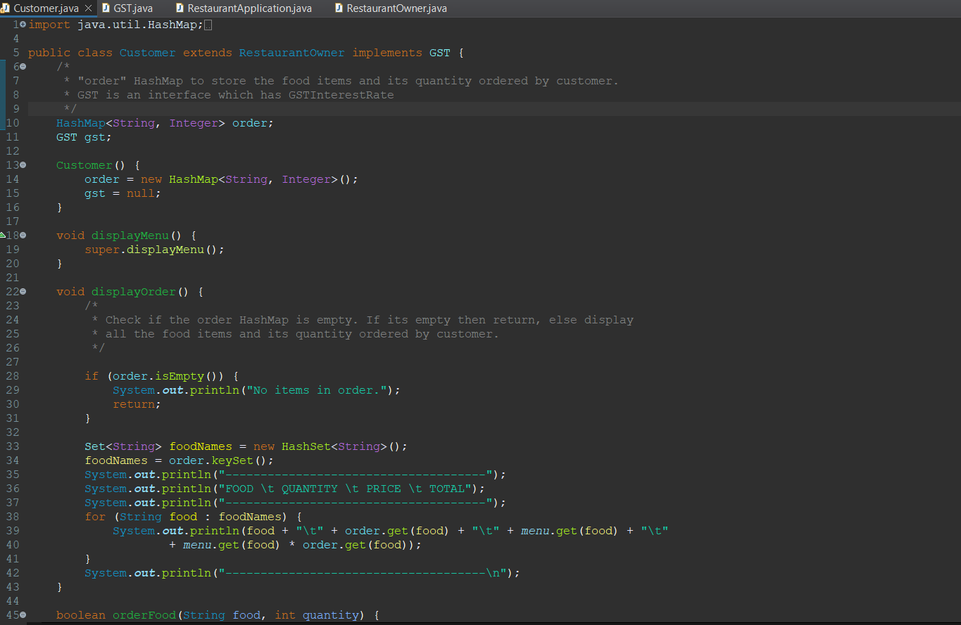
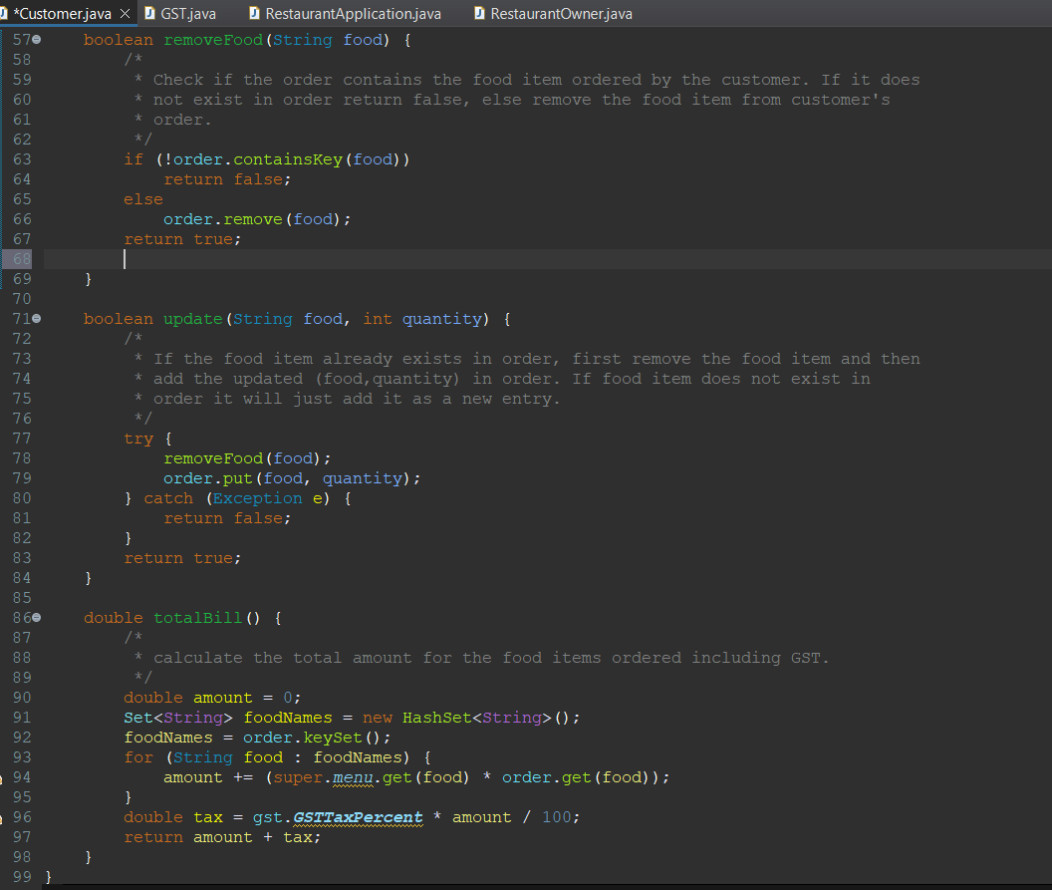
​
Project Implementation

Slide 12
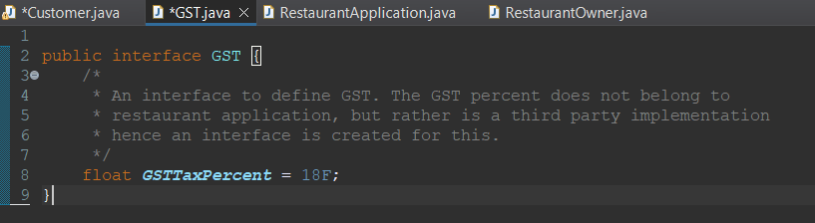
​

Slide 13
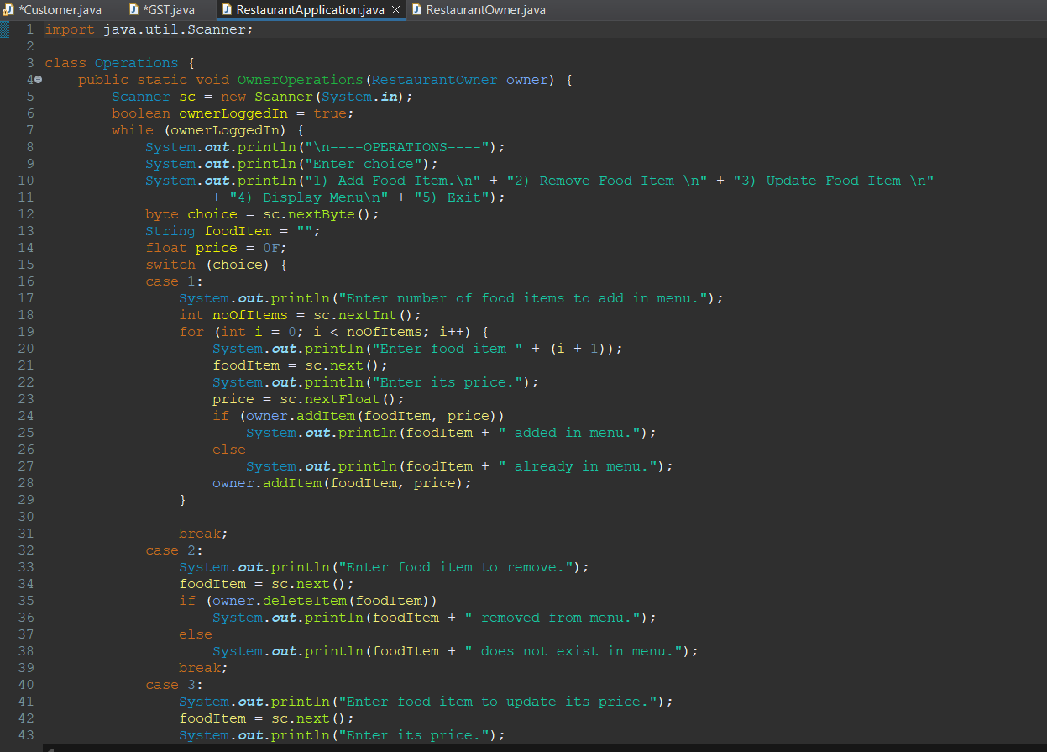
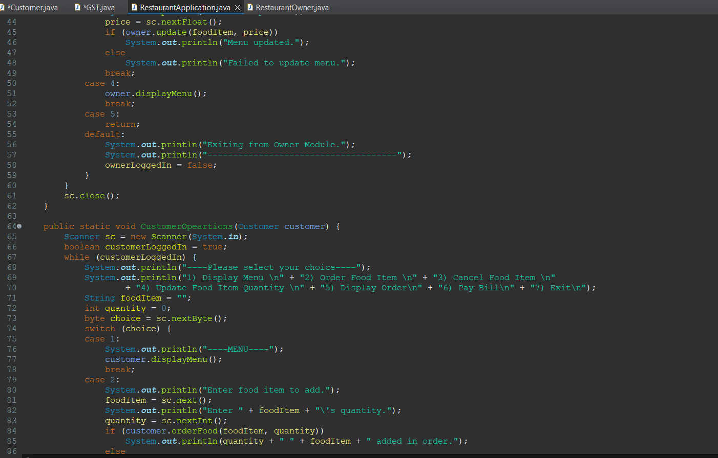
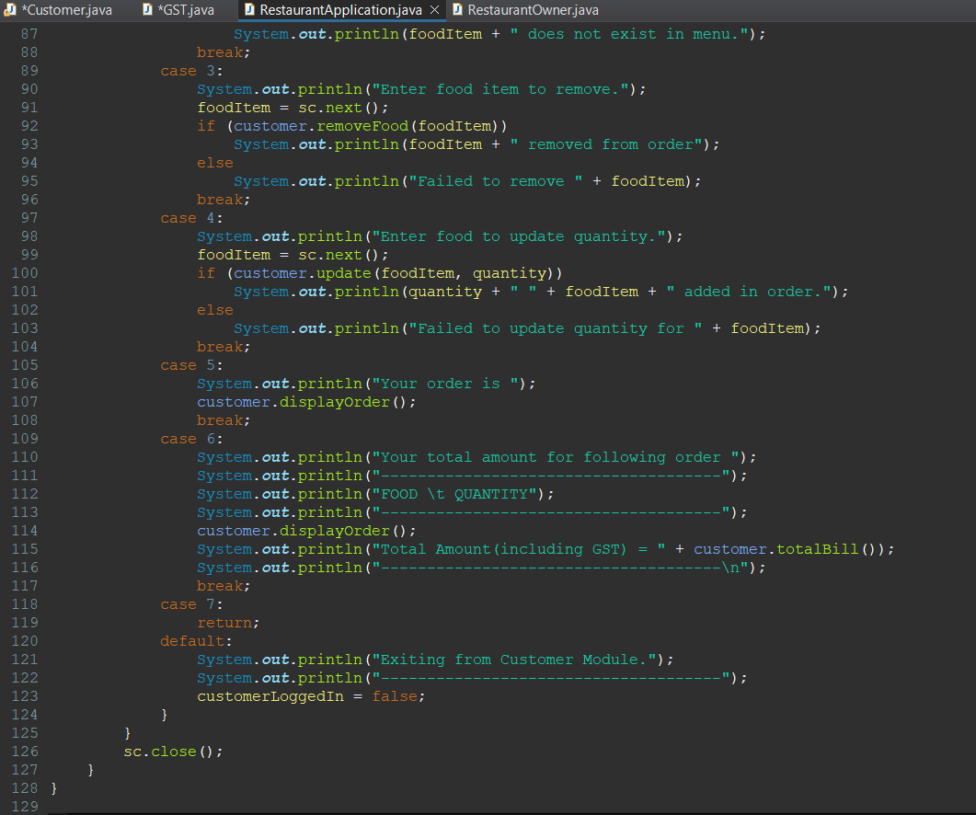
​

Slide 14
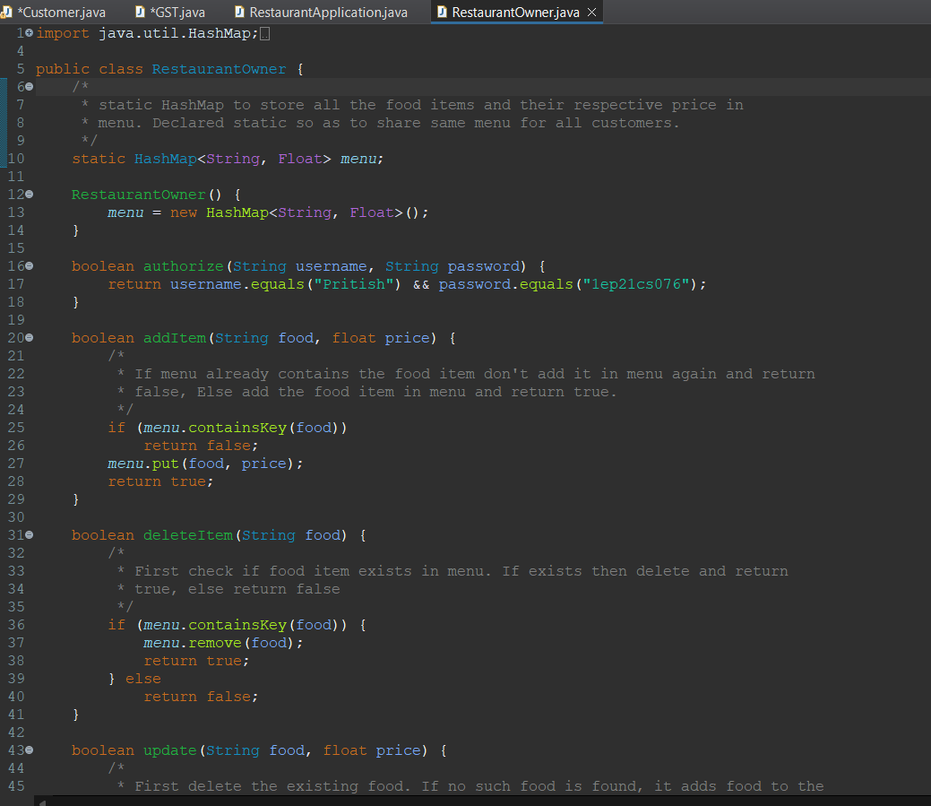
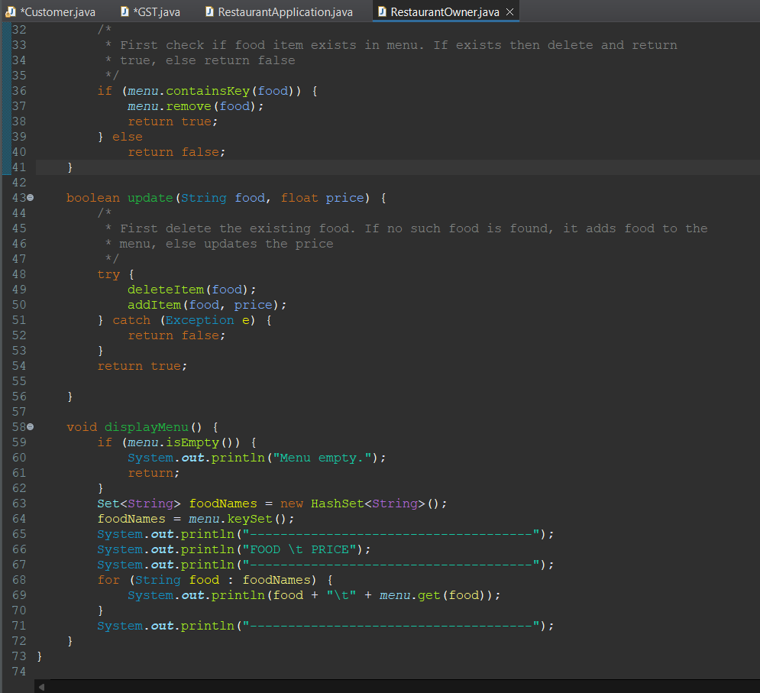
​

Slide 15
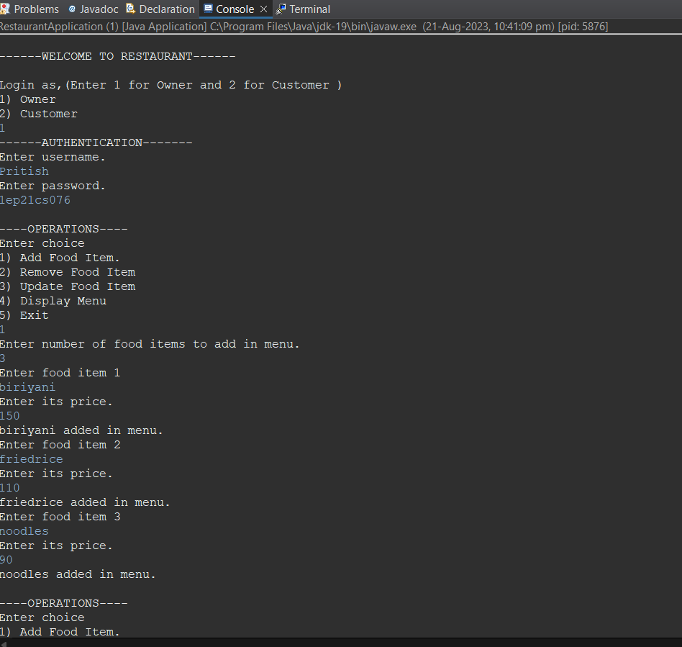
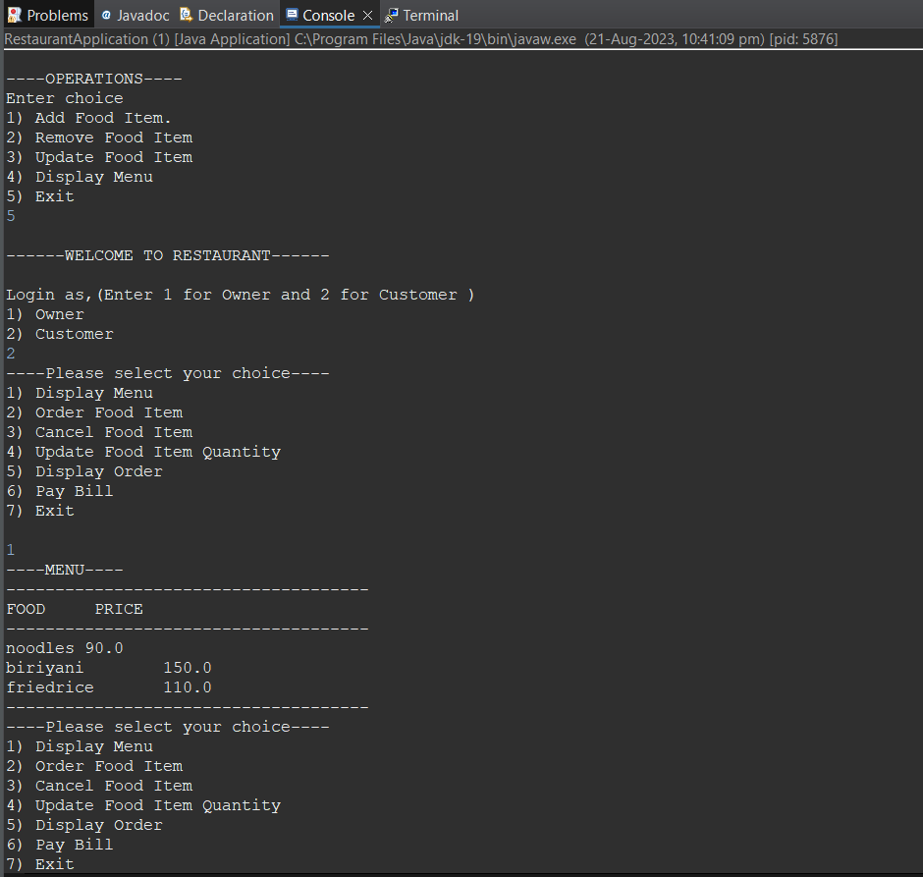
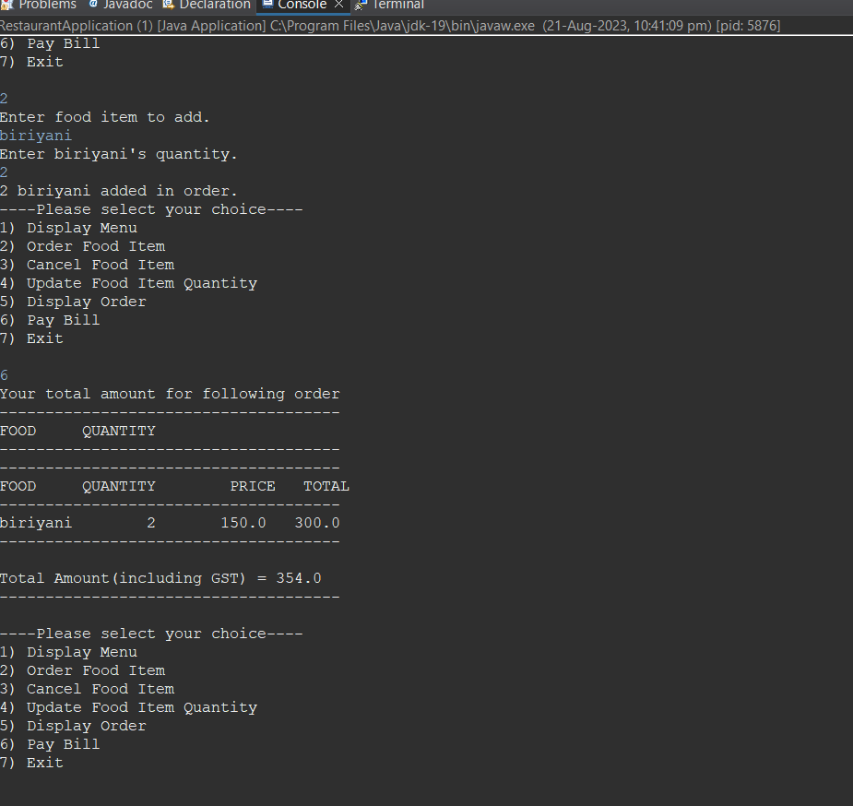
​
Project Output

Slide 16
​
Conclusion
On implementing this project , I learnt the technology Java , servlets and JSP ( which is an extension to servlet ).
The aim of this project was to create a Typing Speed Calculator that would count the Words Per Minute(WPM) , Character Per Minute (CPM) and the accuracy of the typed characters and also throwing some suggestions depending on the performance of the user.
It is not easy to know your accuracy when it comes to typing , but this project will let you know your typing speed along with the accuracy of the typed words.
This will not only help to increase the typing speed of the user but also will also allow them to focus on the words and characters which they have typed i.e., how much accurate they are.
“Ability to reuse the code within the same program is achieved in the object oriented programming by means of extending and implementing , this is what Java is.” , with this I conclude my statement.

Slide 17
​
Reference
Balagurusamy, E. (2007). Programming with JAVA: A Primer, 3rd edition. New Delhi: Tata McGraw-Hill.​
“Head First Servlets and JSP: Passing the Sun Certified Web Component Developer Exam “, by Bryan Basham (Author), Kathy Sierra (Author), Bert Bates (Author), O'Reilly Media; Second Edition edition (April 1, 2008). ​
Arnold, Ken, James Gosling and David Holmes (2005). The Java Programming Language, 3rd edition. NJ: Prentice Hall.​
A Programmer's Guide to Java SCJP Certification: A Comprehensive Primer (3rd Edition), Addison-Wesley Professional; 3 edition (December 29, 2008). ​

Slide 18
​
THANK ​ ​ YOU​ ​
​ By: Pritish Ali USN : 1EP21CS076​

